Slide 1


CA20113- A sound proteome for a sound body: targeting proteolysis for proteome remodeling
The ‘PROTEOCURE’ COST Action

Slide 2


















European Cooperation in Science & Technology
COST provides networking opportunities for researchers and innovators in order to strengthen Europe’s capacity to address scientific, technological and societal challenges
ALL FIELDS OF S&T
(mono- or interdisciplinary, new and emerging fields)
ALL CAREER STAGES
(young and experienced resear- chers)
ALL PARTNERS
(academia, public organisa- tion, industry,
NGO, International Organi- sations)
ALL COUNTRIES
41 COST Full Members
• + 1 Cooperating Member and +1 Partner Member
14 Near Neighbour Countries
Global cooperation
BOTTOM-UP APPROACH

Slide 3
















Benefits of participating
in a COST Action
Scientific
Financial
support
Networking
Career opportunities

Slide 4

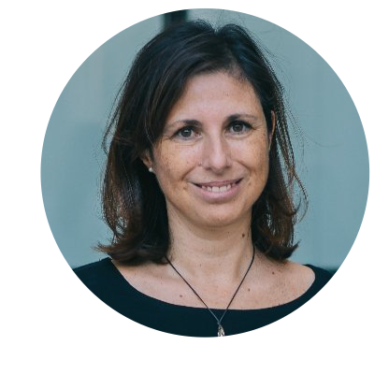

COST Action PROTEOCURE
TARGETING PROTEOLYSIS FOR PROTEOME REMODELING
Duration: Nov 2021 – Oct 2025
ACTION CHAIR
ACTION VICE-CHAIR
GH Scientific Representative
Rosa Farràs, ES
PROJECT MANAGER
Olivier Coux, FR
Laetitia Poidevin, ES
318 Labs members
30 European countries
https://proteocure.eu/
olivier.coux@cnrs.fr
Institut de Genetique
Moleculaire de Montpellier, France
rfarras@cipf.es
Centro de Investigación Príncipe Felipe
Valencia, Spain
proteocuregrantholder@cipf.es
Centro de Investigación
Príncipe Felipe
Valencia, Spain

Slide 5

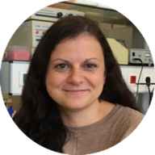
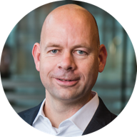
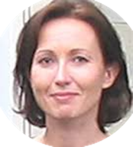

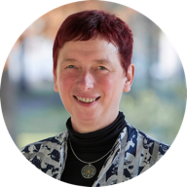

PROTEOCURE Core Group : scientific activities coordination
Grant award coordinator
Rosa Barrio
STSM coordinators
Meetings coordinators
Training schools coordinators
Georgia Chachami
Alfred Vertegaal
Christine Blattner
Makis Skoulakis
Klaudia Brix
Elah Pick

Slide 6
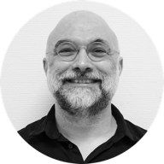

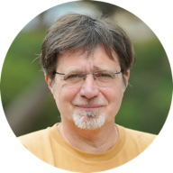
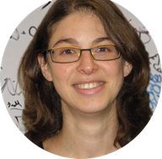
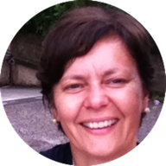
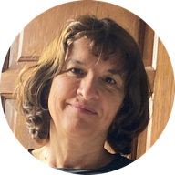
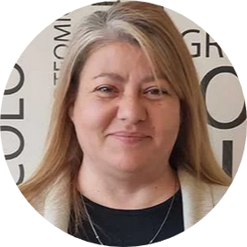
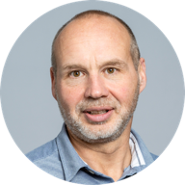
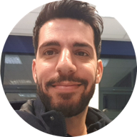
PROTEOCURE Core Group : dissemination & networking activities
Dissemination activities
Science communication
coordinator
Eric Chevet
Manuel Rodriguez
Michael Glickman
Target groups committee
Stakeholders committee
Networking committee
Ayala Shiber
Germana Meroni
Carmen Rivas
Aleksandra Divac
Rankov
Nico Dantuma
Mohamad Abbas

Slide 7
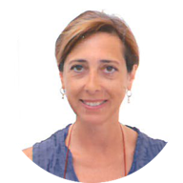
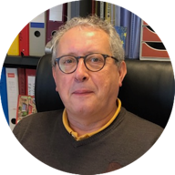
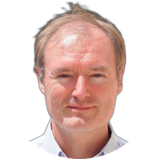
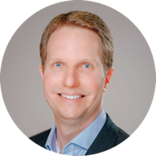
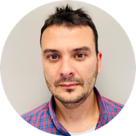
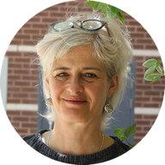
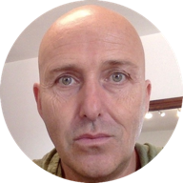
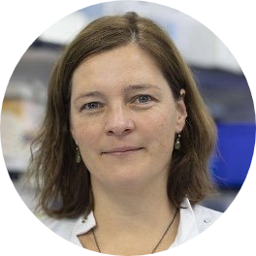
PROTEOCURE Core Group :
Working group leaders
Working group 1
Working group 2
Carmela Giglione
Gilles Lalmanach
Rune Matthiesen
Matthias Stein
Working group 3
Working group 4
Carles Galdeano
Catherine Lindon
Michael Clague
Esther Slammer

Slide 8
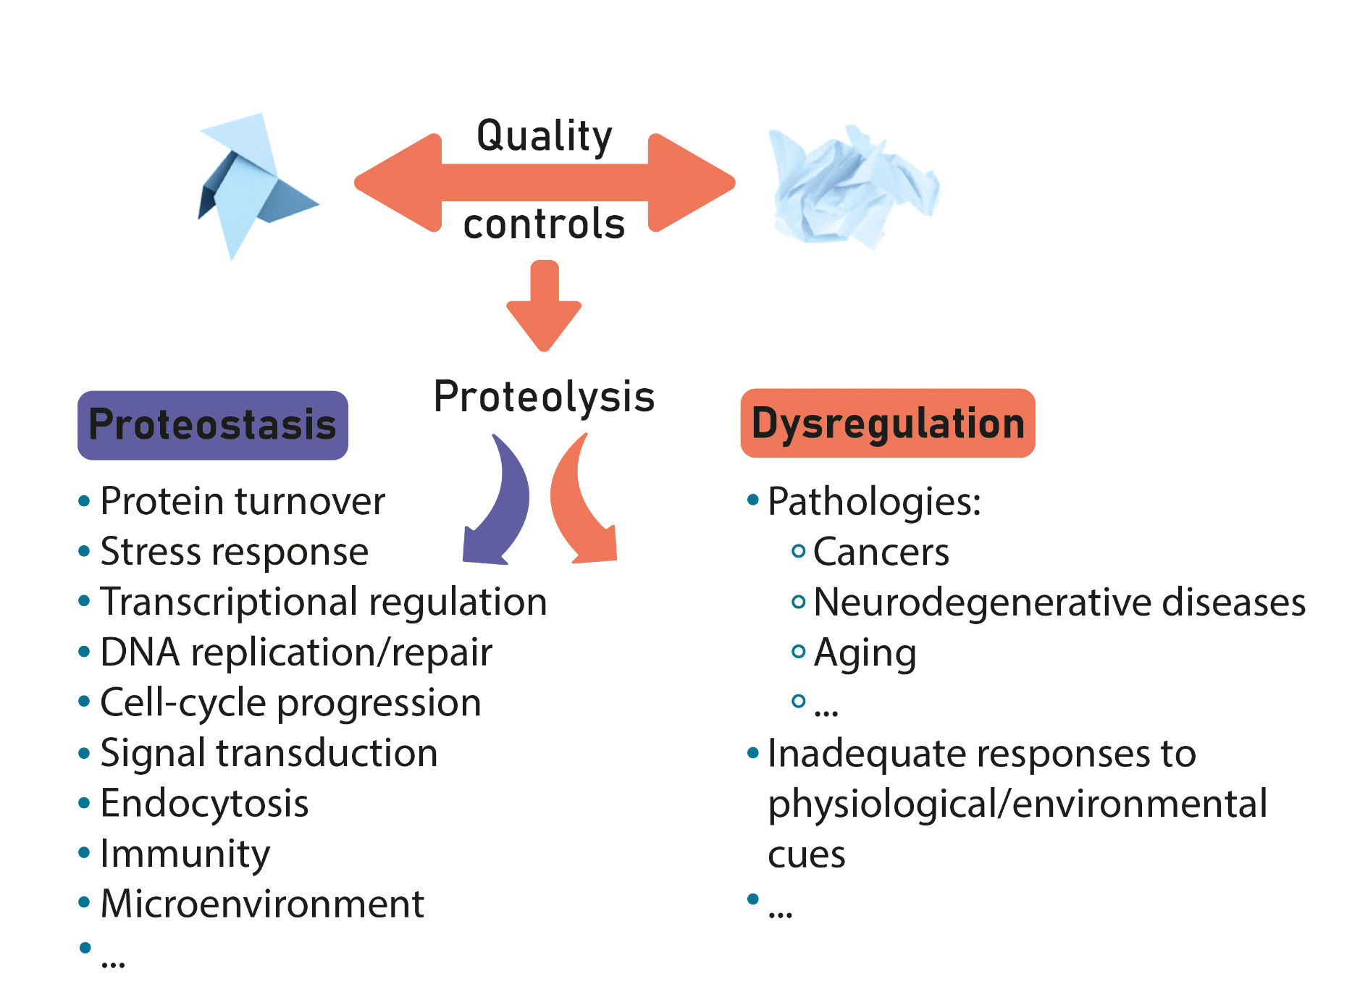
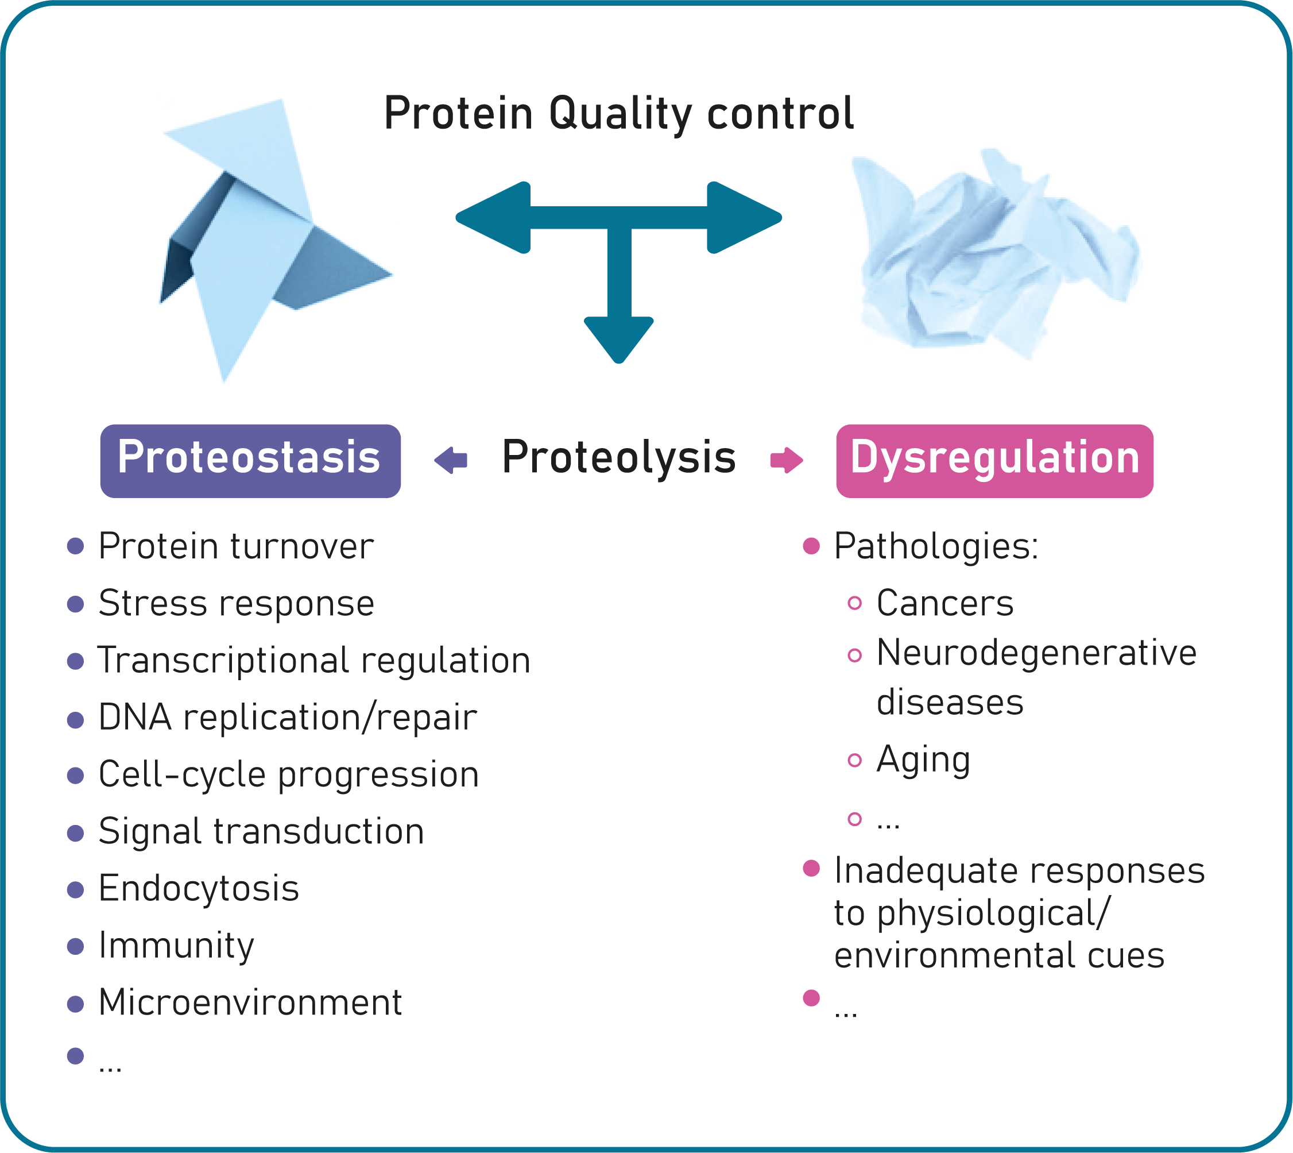
The PROTEOCURE COST Action
RAISON D’ÊTRE OF THE ACTION
To foster European research aiming at reshaping the proteome for therapeutic needs by targeting or highjacking the proteolytic machinery
Generate knowledge
Train people
Foster collaborations (European grants)
Identify targets of therapeutic / biotechnological interest
Develop novel drugs to cure / manipulate

Slide 9
Decreasing the energy barriers
Basic science
Clinics
Industry/ Private sector

Slide 10
Working groups
WG1 goal: to constitue ‘task forces’ per pathology or biological pathway, gathering labs working on the same pathology to share knowledge,
techniques, models, etc.
WG2 goal: to facilitate / foster identification and transational
maturation of molecules active on relevant and validated proteostasis targets.
WG2
Screening /
Identification and targeting of active molecules
WG1
Pathologies / pathways
WG3
Directed
proteolysis
WG4
ACI Network
WG3 goal: to promote directed
proteolysis approaches in Europe by favouring the development of bridges between biologists and chemists.
WG4 goal: to promote integration of ACI (Academic, Clinician,
Industrial) sectors in order to
create a fertile environment for
rapid translation of discoveries and ideas into innovativa therapies..

Slide 11
Working groups
WG2
Pathol.1
Pathway x Pathway y Pathway z
WG3
Pathol. X
Pathway 1
Pathway 2
Pathway 3
Pathol.2
Pathway a Pathway b Pathway z
WG1
Pathol.3
Pathway e Pathway f Pathway g
WG4

Slide 12

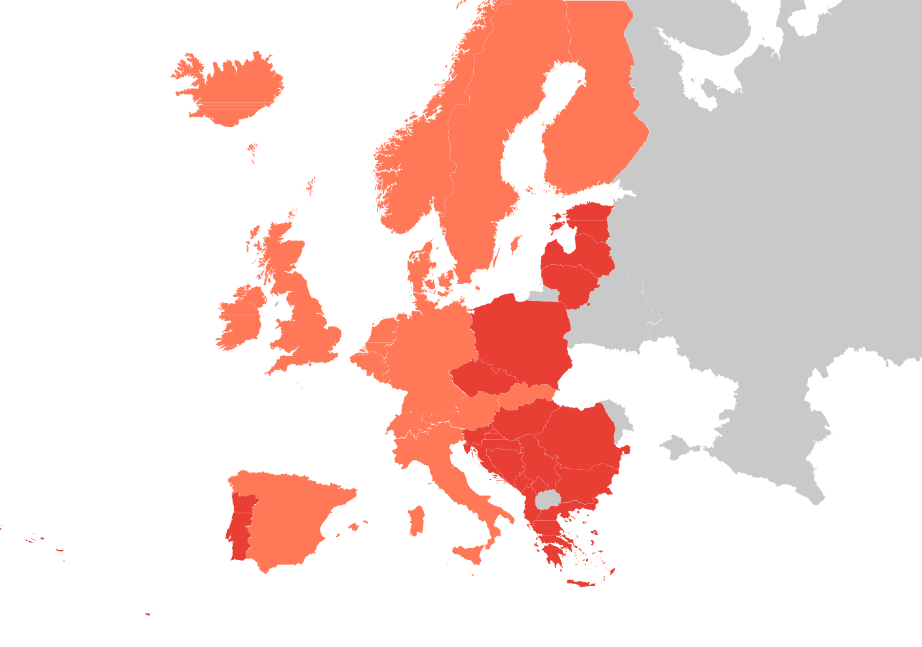
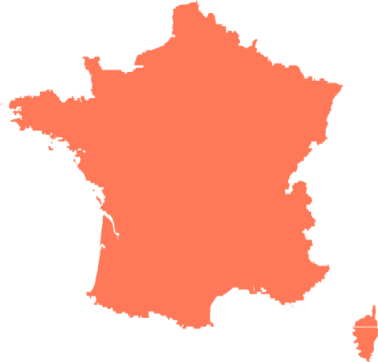
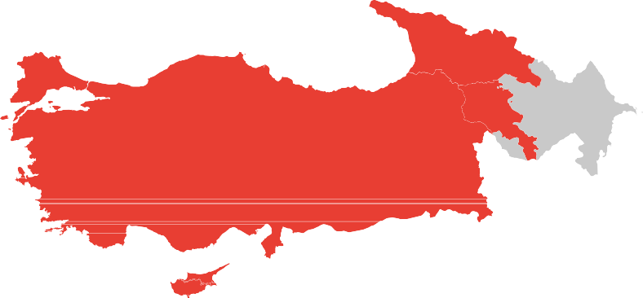

Collaborative activities & tools
Meetings
ProteoCure meetings or co-organized meetings
In person or virtual
STSMs (Short term scientific missions)
Exchanges between labs
Training schools
Dissemination: Dissemination conference grants, newsletters, mailing lists, webinars…
ITC conference grants: support for Young
Researchers and Innovators from participating
Inclusiveness Target Countries/Near Neighbour
Countries to establish a strong network and increase their visibility in the research community.
See proteocure.eu for details

Slide 13
Collaborative activities & tools
Also,
Webinars
Mailing lists
Detailed information of members on website, including research interest, emails etc.
Job offers
Forum
See proteocure.eu for details

Slide 14
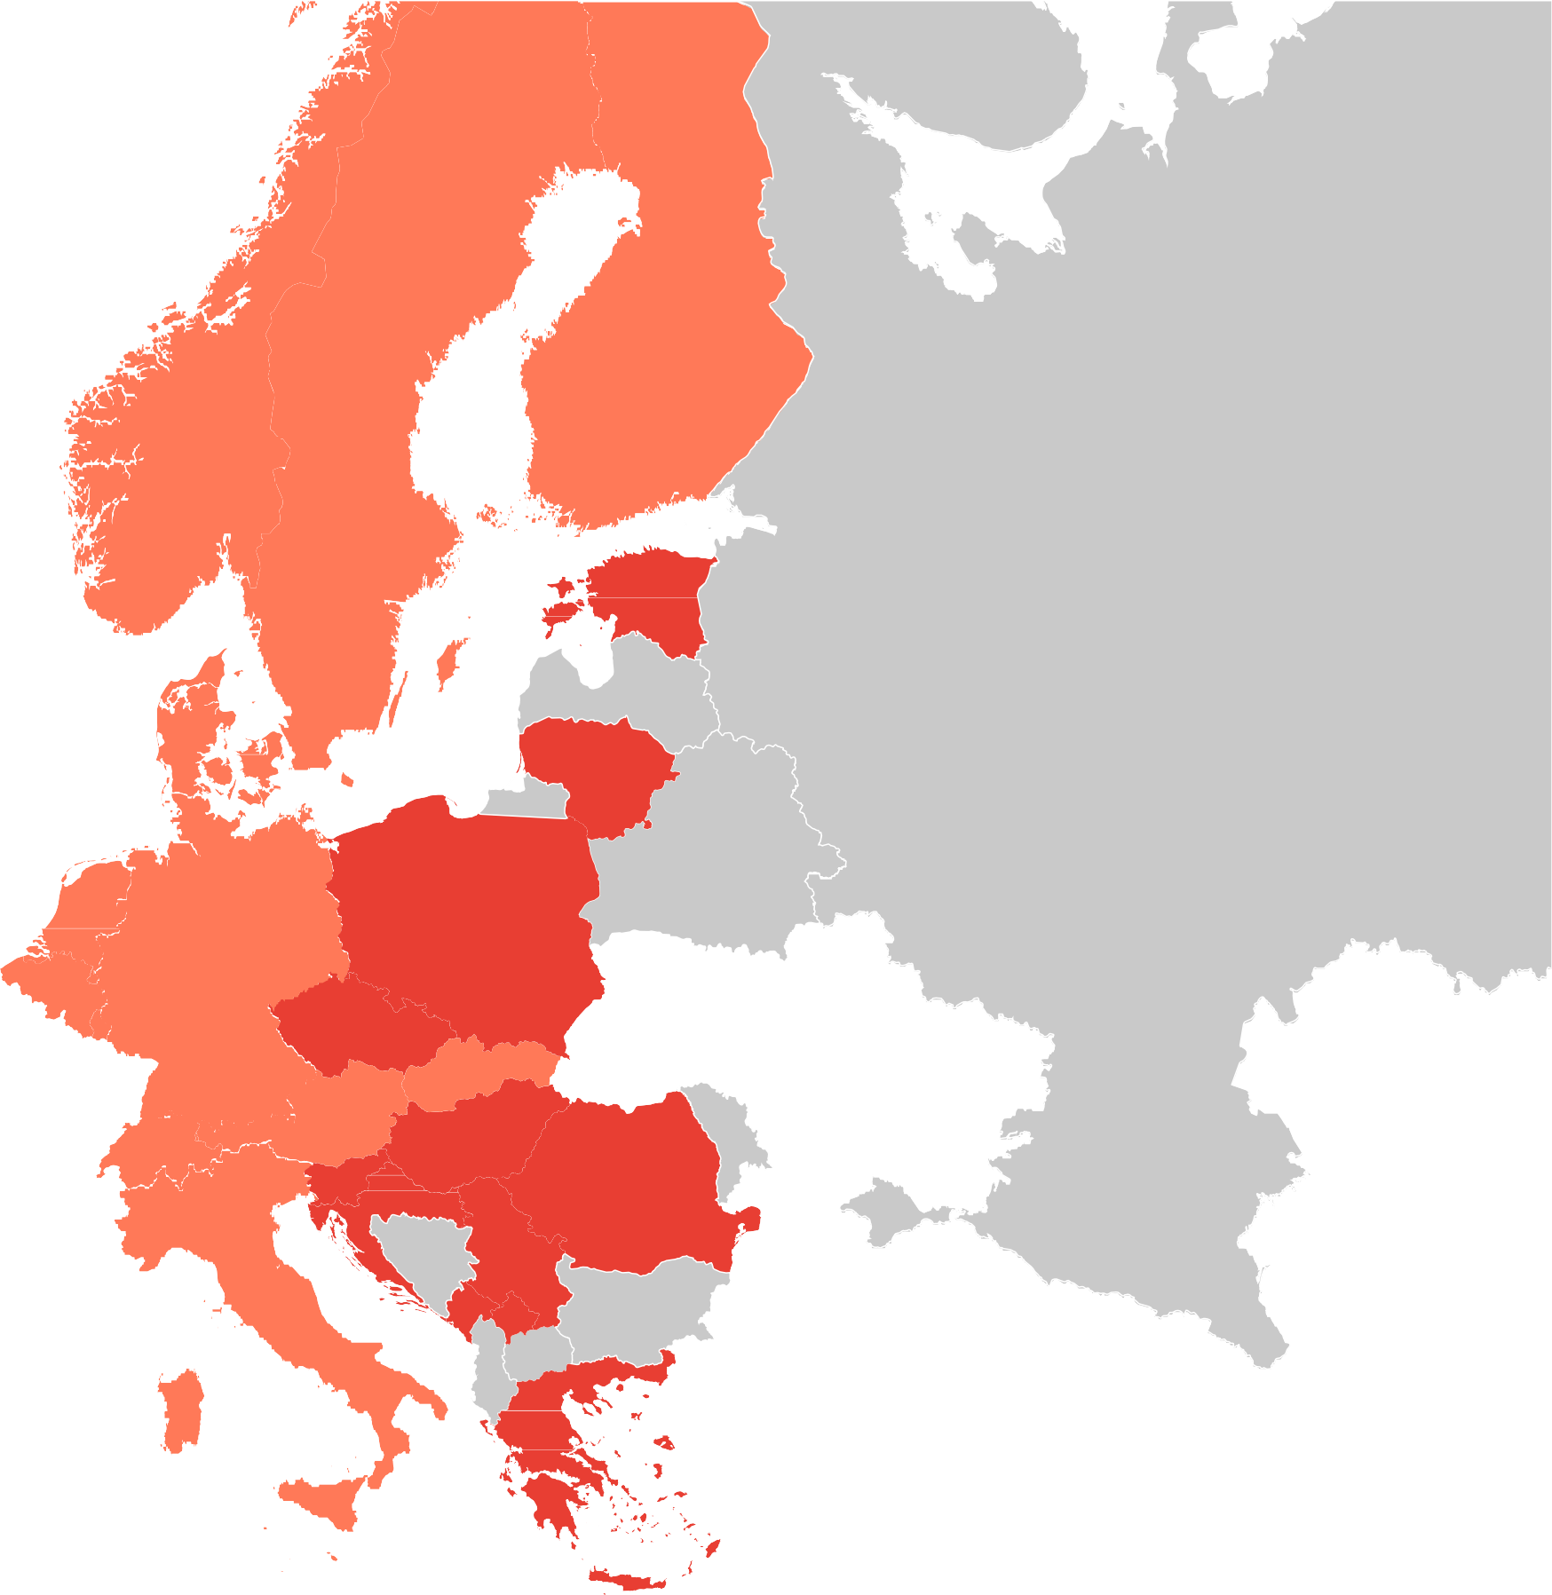
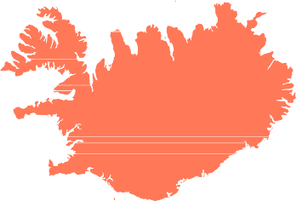

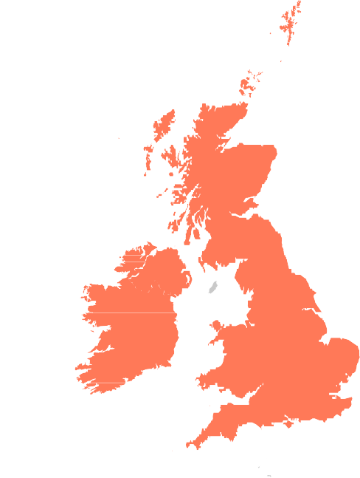
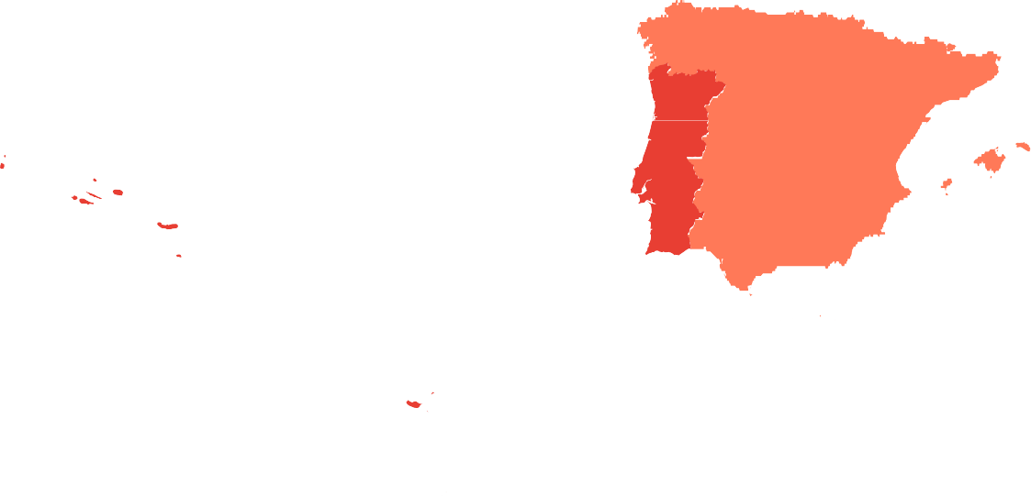
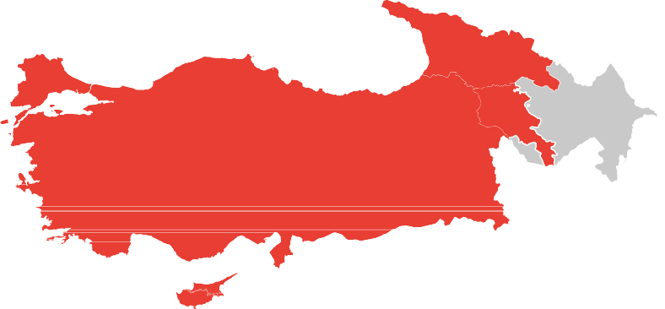

PROTEOCURE Membership
30 Members
Austria Belgium Croatia Cyprus
Czech Republic Denmark
Estonia Finland France
Germany Greece
Iceland Ireland
Italy
Lithuania
Luxembourg
The Republic of Moldova The Netherlands
Norway Poland Portugal Romania Serbia
Slovenia Spain Sweden
Switzerland Turkey
United Kingdom
Israel
318 Participating Teams
COST Members non-ITCs
(Inclusiveness Target Countries)
COST Members ITCs
COST Cooperating Member

Slide 15
Open Research Europe
ORE is the EC’s Open Access publishing platform for scientific articles for Horizon Europe.
As from 30 September 2022, COST Actions can submit directly to this publishing venue, free of charge.
ORE is a reliable peer-reviewed publishing service of high scientific quality, with swift publication times.
Submitted publications must be original, not be submitted anywhere else for publication, and stem from COST Actions. ORE accepts
articles in all fields of science.
Please note that this is complementary to the existing Open Access expenses covered by the COST rules.
For more info visit the ORE website: https://open-research-europe.ec.europa.eu/

Slide 16
Join us!
www.proteocure.eu
@ProteoCure
www.youtube.com/@proteocure9354

Slide 17
THANK you!

